Slide 1

THE ART OF CODE
Satria Ady Pradana

Slide 2
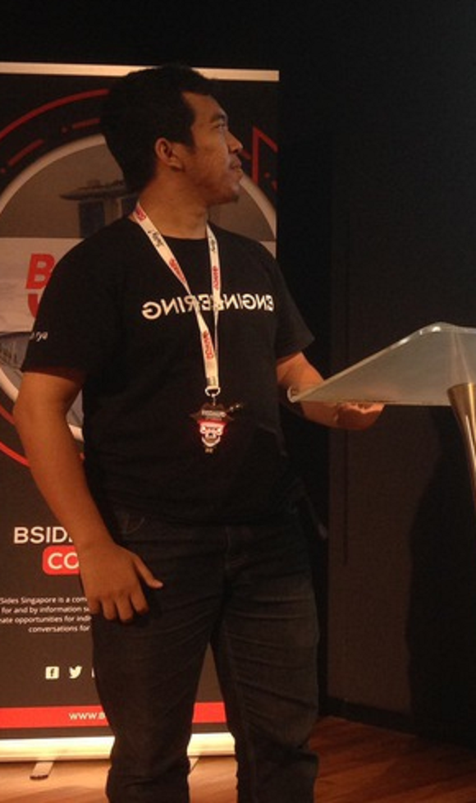



Who?
Satria Ady Pradana
Cyber Security Consultant at Mitra Integrasi Informatika
Co-Founder of Archonlabs SSD
Penetration Tester, Red Team
Community Leader of Reversing.ID
@xathrya
xathrya
xathrya_

Slide 3
CODe & programming
Relevance in Cyber Security

Slide 4
packet crafting
penetration testing
fuzzing
Cyber Security
forensic
reverse engineering
machine learning
web scraping
exploit development

Slide 5
Programming
Process of creating computer program.
Using language that machine can understand in order to get it to perform various tasks.
Computer program is running on top of a platform
Native: same instructions provided by hardware/processor.
Interpreted: translated by runtime environment.
Computer program is a group of logical, mathematical, and sequential functions.
When grouped, these functions perform a task.
Often have data to be processed.
Each programming language has its own characteristics

Slide 6
Why Important?
Many aspect of our life interact with product of digital technology.
Integral role in our world.
World is now technology-driven.
Even more impactful in the future.
Programming means as a problem solving medium.
Automate repetitive tasks.
Build and adjust

Slide 7


Programming & Cyber Security
What can you do?
Create or adjust tools
Plugins/extensions
Create bot
Audit source code
Finding bug
Reverse engineering
Offensive Red Team
Defensive Blue Team

Slide 8
Offensive Operation
Engagement in before, during, and after exploitation.
Interact with target (host, service).
Setting up infrastructure.

Slide 9
Defensive Operation
Detecting and hunting anomality.
Collect and parsing logs.
Query
Setting up infrastructure.

Slide 10
LANGUAGE CHARACTERISTIC
Every language is unique.
Syntax
Paradigm
Features
Which programming language is suitable for me (making tools)?
Depend on cases

Slide 11
Learn new language?
Master the fundamental of programming language:
Decision making (if, else, switch, etc).
Loop
Function
Learn the characteristic of the language.

Slide 12
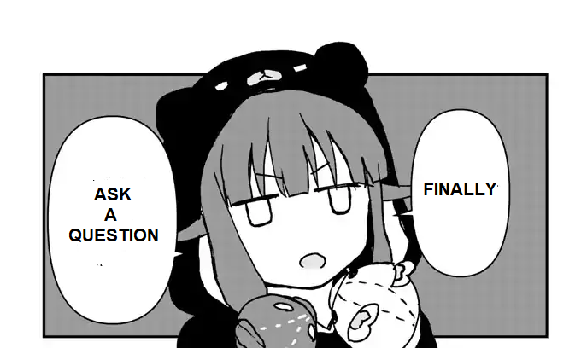

Slide 13
Thank You
Satria Ady Pradana
spradana [at] archonlabs.id
@xathrya (telegram)

